Slide 1
MCCP6020 Advanced English for Academic Purposes
Session 4
Giving an Academic Oral Presentation (Conference Paper Presentation Skills)

Slide 2
Learning Outcomes
By the end of this session, students should be able to:
structure an academic presentation using appropriate transitional phrases
apply effective communicative strategies to the delivery of formal academic presentations
explain subject-specific concepts to a non-specialist audience in academic presentations using appropriate strategies; and
explain orally the key concepts and research findings in the literature
handle questions from the audience appropriately in academic presentations

Slide 3
Task 1
Academic conferences offer research postgraduates the opportunity to present ongoing work and discuss their research with peers and scholars in the field. How much do you know about the academic conferences in your field? What preparation work do you need to do before presenting your research at a conference? Discuss the following questions with a partner:
Conduct an online search for an academic conference that you might be interested in attending. What are the types of presentations for the conference?
Possible answers: Full paper (20-40 mins), short paper (10 mins), workshop, poster, panel presentation/discussion, roundtable discussion
What are the guidelines for preparing an abstract/a full paper as stated on the conference website?

Slide 4
Task 1
What preparation work is needed for a conference presentation?
Select a relevant and reputable conference. Check that your research matches the themes of the conference.
Use a ‘catchy’ title for your presentation because many presentations are run in parallel in most conferences.
Follow guidelines set by the conference organizers (length, layout, references, etc.), and prepare an abstract or a full paper (depending on the requirements set by the conference organisers).
What do you need to consider when preparing the content of a conference presentation?
Is the purpose clearly stated?
Is the thesis/topic clearly stated?
Are the arguments/ideas supported with evidence?
Are all the contents relevant to the topic?
Is the level of technicality suited to the audience?
Is the organization of ideas clear?
Are the visual aids well-designed?

Slide 5
Task 2 Analyse Your Audience
Knowing your audience is critical when preparing for a conference presentation. Anticipating the interests, needs, background and knowledge of the audience will help you connect your specific research to the general interests/concerns in the field. This will make your presentations more interesting and relevant to the audience.
Here are some questions you should consider when analyzing your audience in a conference presentation:
Who are likely to be your audience?
What do you think your audience would like to find out about your research?
What are the main aims of the conference? (Review the theme and the key words/concepts of the conference)
What are the primary concerns of the field? (How do you bridge the gap between your research and your field’s broader interest and concerns?)
How can you contextualize your research within the trends/developments in the field?

Slide 6
Task 2
Imagine that you are going to give a presentation at the academic conference you had identified in Task 1 Q1. Analyse your audience using the questions above. Make notes in the box below and share your views with a partner.

Slide 7
Basic Structure of a Conference Presentation
In a conference presentation, you need to choose an aspect of your research that can be concisely conveyed to an audience within the timeframe (usually about 20 minutes + 5-10 minutes for Q&A) you are given. Do not attempt to cover your entire PhD thesis. A useful simple structure is shown below:
What is the issue and why is it worth researching?
Your approach to examining the issue (Methodology)
Your findings/results
What are your conclusions and their implications

Slide 8
Task 3
General Rules for Giving an Academic Presentation
As a graduate student, you have many opportunities to give academic presentations at academic seminars and at academic conferences. Being able to give an engaging and a well-organized presentation is an invaluable skill that you should develop during your postgraduate studies.
Watch a video on “Academic Presentation Skills” prepared by the University of Melbourne. The video summarizes the general rules for an academic presentation. Link to the video: https://www.youtube.com/watch?v=pNIO5KkIq7Y
Watch part 1 of the video (0:00-5:50) about planning and structuring your presentation. Take notes and use your notes to answer the following questions:

Slide 9
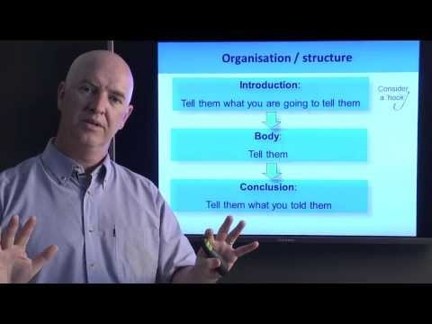
What are the five things that presenters need to know when preparing for a presentation?
What is the general structure of an academic presentation?
The speaker mentioned using a hook at the beginning of the presentation to engage the audience. What are some possible ways suggested by the speaker?
According to the speaker in the video, what are some examples of functional language that give signals to the audience about what the presenter is saying? Can you think of other signalling and transition words for oral presentations?

Slide 10
1. What are the five things that presenters need to know when preparing for a presentation?
2. What is the general structure of an academic presentation?
Divide information into sequenced chunks
Be aware of multiple sensory channels – 2 visuals (you and slides) & 1 audio (you)
What you say is only part of the message. Non-verbal behaviour is also very important.
“Call to action” – What do you want them (the audience) to know or do?
People imitate your emotions, so be positive
Introduction – Tell the audience what you are going to tell them (Consider using a hook)
Body – Tell the audience the content (Split into section with a logical sequence)
Conclusion – What you have just told the audience (Recap: take away message)

Slide 11
3. The speaker mentioned using a hook at the beginning of the presentation to engage the audience. What are some possible ways suggested by the speaker?
4. According to the speaker in the video, what are some examples of functional language that give signals to the audience about what the presenter is saying? Can you think of other signalling and transition words for oral presentations?
Tell a relevant story
Use a visual
Tell some interesting facts
Ask a question
To summarize – To sum up…
Sections – The first part of the presentation deals with… /The next thing I am going to talk about is…
Transitions – Let me move on to…/Moving on to the next point…
To rephrase/clarify – Let me rephrase/Let me point out that…
To emphasise – It is important to note that…

Slide 12
Language for the introduction of an oral presentation Introduce the topic: This presentation will investigate/ examine/ identify/ the effects of … My topic today is … The topic I intend to discuss is … Our team/group will be discussing … Provide an outline of the presentation: I want to start by …, and then I’ll … Let’s begin by … , before looking at … I’m going to divide this talk into three parts. There are four main points I’d like to discuss: X, Y, Z and A. The effects of … will be shown by a comparison of x and y. Language for referring to visuals Draw the audience’s attention to the visual: Now, I'll show you … As you can see here … I’d like to point out … The diagram indicates … Let's move on and look at the graph of … Language for the conclusion of an oral presentation To sum up ... In conclusion ... To recapitulate ... To conclude ... In summary ... To summarize ... | Language for the body of an oral presentation Introduce a main point: A major concern is … Fundamentally ... The central problem is that … A significant issue has been ... Move to another point: Now let's consider ... I'd like to move on to/look at … If I could now turn to ... My next point is ... Now, turning to ... Let me move on to ... Rephrase a point: That is to say ... The point I am making is ... Let me put that another way ... In other words, ... As I have been saying ... Introduce an example: Let me illustrate this by ... Take the case of … This is illustrated by... This is demonstrated by… An example of this is … Language for inviting questions Are there any questions you’d like to ask? Does anyone have any questions? I’m happy to take any questions. Would anyone like me to explain anything further?
Other signalling and transition words for oral presentations:

Slide 13
Now watch part 2 of the video (5:51-9:19) about engaging the audience. Take notes and use your notes to answer the following questions:
1. What are the three essential things in a presentation that can engage the audience?
2. What is body language? Why is body language so important?
3. How can presenters avoid using monotone delivery in presentations?
Body language 2) Voice 3) Visuals
Body language includes eye contact, posture, hand gesture, facial expression, etc.
Effective use of body language can help the speaker to give emphasis, work off nervousness, and convey messages more effectively.
Memorise key points but not the whole talk. Use your voice as an emphatic device. Prepare a list of bullet points which are the key points of the presentation. Highlight the key words and think about how you might emphasise them.

Slide 14

Task 4
Improving Delivery Skills – Body Language, Rhythm and Sentence Stress
Body Language
Watch the first two minutes of a TED talk on the topic “A New Class of Drugs that Could Prevent Depression and PTSD”. Observe how the speaker uses body language (eye contact, hand gestures, body posture) to help convey messages effectively. (Link to the TED Talk: https://www.ted.com/talks/rebecca_brachman_a_new_class_of_drug_that_could_prevent_depression_and_ptsd#t-118928)

Slide 15
Task 4
What body language does the speaker use?
The speaker uses hand movements naturally to communicate messages. She maintains eye contact with the audience throughout the presentation. She stands straight and shows confidence when she speaks. Also, she tries to connect with the audience in different parts of the room by making slight movements and showing enthusiasm to speak to the audience.

Slide 16
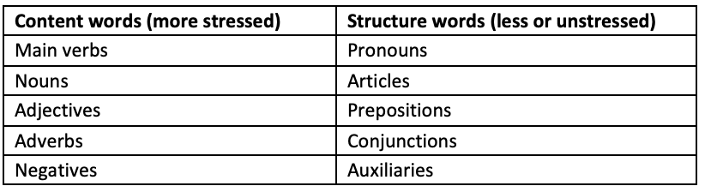
Rhythm and Sentence Stress
The appropriate use of sentence stress, intonation, pausing and pace create a smooth rhythm which makes a speaker sound fluent. There are two general rules that can be applied to sentence stress.
Content words are those that carry meaning or sense such as verbs, nouns and adjectives. These are usually given more stress because they carry most of the meaning.
Structure words are small words such as articles, pronouns and prepositions that ensure grammatical correctness. These are generally unstressed.
The table below illustrates these two general rules.

Slide 17
As well as rules about content and structure words, two other aspects need to be taken into account when improving the overall rhythm and fluency of speech.
Emphatic / Contrastive stress can be placed on any kind of word to create certain meanings.
Sense groups are clusters of that form a meaningful unit usually indicated by a pause (brief or long, often between breath), the use of a “filler” (e.g. “em”, “ar”, “well”, “so” etc.) or the lengthening of a final word sound (e.g. “Soooo”). These features are normal in everyday spontaneous speech but if there are too many pauses and fillers then the smoothness of the rhythm breaks down and it places a strain on the listener.
Watch the first minute of the TED talk again and mark the following on the transcript below:
Mark words that are stressed by underlining them.
Place a red line | where you think there a sense group is or a noticeable pause.

Slide 18
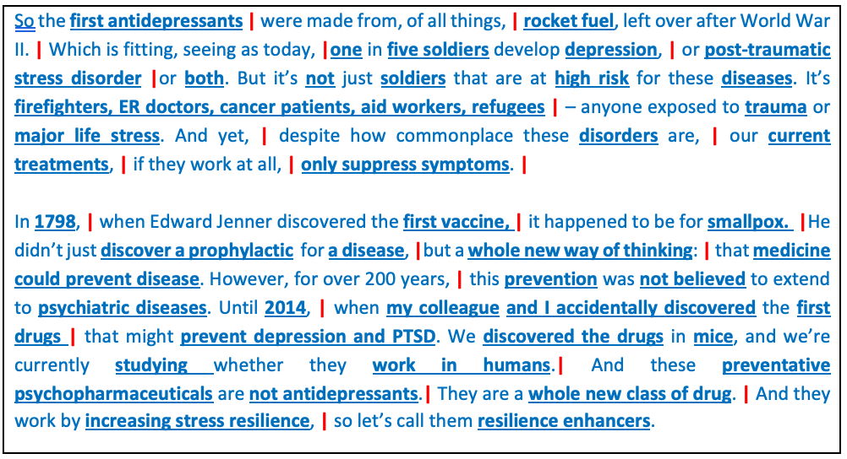
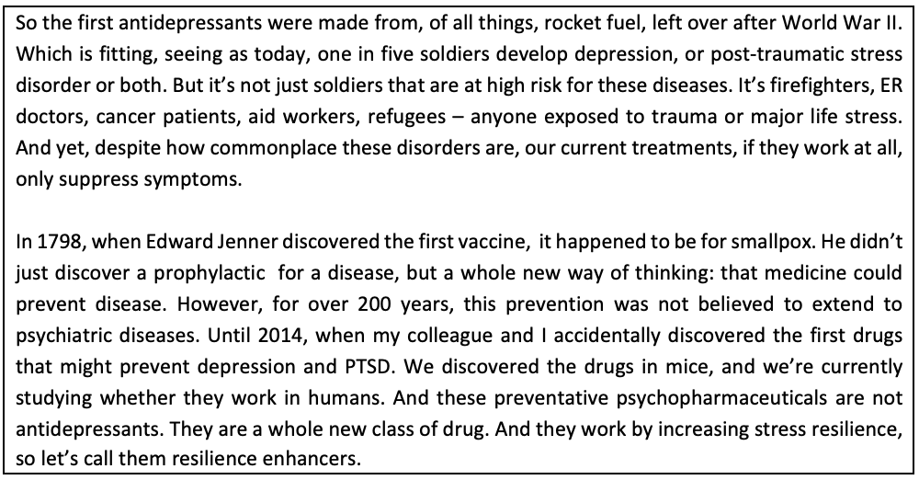
Task 4

Slide 19
Task 5
The following videos showcase good examples of conference presentations. Work in pairs to watch one of the videos and evaluate it based on the criteria outlined in the table below.
Alliance Manchester Business School Research Conference - Business:
https://youtu.be/P7kUI6prT_Y?si=kgbngClilshoU8Jp
Center for Values' Conference on Science Policy and Interaction - Public Health (from 18:51):
https://youtu.be/_kLe_GDjw7k?si=yec7i5EO2otLubAw
IEEE Conference (Computer Science and Engineering):
https://youtu.be/-pUXicoE1ek?si=vXW2Fu8DI3gS_oFo

Slide 20
Criteria | Guiding Questions | Comments
Content Quality | Clarity of Objectives: Are the research goals clearly stated? Depth of Research: Is the methodology sound and well-explained? Explanations of the Results/Findings: Are the results/findings well-explained? Originality: Does the work contribute new insights or findings to the field?
Organisation | Structure: Is the presentation logically organized (introduction, methods, results, conclusion)? Flow: Does the presentation transition smoothly between sections? Time Management: Is the presentation delivered within the allotted time?
Presentation Skills | Clarity of Speech: Is the presenter articulate and easy to understand? Engagement: Does the presenter maintain eye contact and use body language effectively to engage the audience? Confidence: Does the presenter exhibit confidence throughout the presentation?
Visual Aids | Quality of Slides: Are the slides visually appealing and easy to read? Use of Graphics: Are charts, graphs, and images used effectively to support the content? Minimal Text: Is text kept to a minimum, focusing on key points?
Audience Interaction (if the Q&A session is included) | Q&A Session: How well does the presenter handle questions from the audience? Encouragement of Discussion: Does the presenter invite feedback or discussion?
Overall Impact | Memorability: Does the presentation leave a lasting impression? Takeaway Message: Is there a clear takeaway or message for the audience?

Slide 21
The table below shows some examples of expressions used in conference presentations:
Research Motivation | “The impetus for this study stems from...” “This research is driven by the need to address...” “We were prompted to investigate this issue due to...” “The pressing question we seek to answer is...”
Methodologies | “We employed a mixed-methods approach, which involved...” “The research design was structured around...” “To ensure robustness, we utilized...” “Our methodology encompasses both qualitative and quantitative techniques, specifically...”
Results/Findings | “The findings reveal a significant correlation between...” “Our data indicates that...” “We observed noteworthy trends, particularly in...” “The analysis demonstrates that...”
Significance of Research | “This research contributes to the field by...” “The implications of our findings suggest that...” “This work is particularly important because it...” “By addressing this gap, we advance our understanding of...”
Research Contributions | “This study makes several key contributions, including...” “One of the primary contributions is...” “Our findings provide new insights into...” “We propose a novel framework that...”
Limitations | “It is important to note the limitations of this research, which include...” “This study is constrained by...” “While our findings are significant, they should be interpreted with caution due to...” “One limitation of our approach is...”
Future Research Directions | “Future research could explore...” “We recommend that subsequent studies investigate...” “An avenue for further exploration is...” “Building on our findings, future investigations might focus on...”

Slide 22
Handling Questions from the Audience in a Presentation
Academic presentations usually end with a Q&A session. How to handle audience questions effectively is a key part of any presentation. When the audience ask questions, you know you have engaged them. It is a good opportunity for you to get feedback on your presentation and your research. From the audience’s questions, you will also find out which part(s) of your presentation the audience find interesting or which part(s) of your presentation need(s) clarifications.
In order to prepare yourself for the Q&A session, you should try to anticipate the most likely questions that you will be asked. You may not predict every question the audience has, but if you are prepared for some of them and have practiced your responses, you will look more confident and professional.

Slide 23
Here are some suggested steps for handling questions from the audience:
Welcome questions from the audience.
Listen carefully and actively.
Repeat or paraphrase the question if the room is large, or if the questioner has a quiet voice.
Ask for clarification tactfully if the question is unclear.
Keep your answer brief and clear.
Make eye contact with the questioner and the audience when answering the question.
Check that the questioner is satisfied with your answer.
Admit it if you do not know the answer. If appropriate, say that you will find out and get back to them.
In some circumstances you may open up the question to the whole audience.

Slide 24
Some useful expressions for the Q&A session:
Welcome questions from the audience: Thank you for listening. If you have any questions, I would be pleased to answer them. That brings me to the end of my presentation. Thank you for your attention. I’d be glad to answer any questions you might have. Ask for clarification tactfully: When you say…, do you mean…? I’m sorry but I’m not sure I understand what you mean by… Check that the questioner is satisfied with your answer: Does this answer your question? I hope this explains the situation for you. Admit that you do not know the answer: That’s an interesting question. I don’t actually know off the top of my head, but I’ll try to get back to you later with an answer. I’m afraid I’m unable to answer that at the moment. Perhaps I can get back to you later.

Slide 25
Task 6
Practice Your Delivery Skills: Using Your Voice and Body Language Effectively
Imagine that you need to explain your research methods to the audience in an academic conference. Find a partner and practice delivering the information in two minutes. You may use the guiding questions below to help you prepare your speech. Feel free to add any information which you think is relevant to your research design. Pay special attention to the use of your voice (volume, rhythm, sentence stress and tone) and body language. Use your phone to video/audio record your speech so that you can do a self-evaluation later.
What is the overarching research question? Or what is the main hypothesis?
What research methods will you use? (e.g. survey? experiments on humans or animals?)
What kind of data will you collect?
What materials, if any, do you need to conduct the research?
What is the research procedure?
How will you analyze the data?

Slide 26
Task 7
Giving an Academic Presentation to a Non-specialist Audience
Being able to explain your disciplinary knowledge and concepts to a non-specialist audience is an important skill that graduate students need to develop. For example, when presenting at international conferences, there may be some non-specialist audience. It is also common for academics to carry out cross-disciplinary research which requires collaboration between researchers from various disciplines. Therefore, researchers should be able to explain their disciplinary knowledge to the experts in other fields. There are a number of skills that you can use when explaining the technical concepts/knowledge to the non-specialist audience:
Avoid unnecessary technical jargon
Use metaphor
Use visuals
Give definitions
Use examples
Relate the topic to the audience’s everyday life if possible

Slide 27

Watch a winning example from the 3-minute thesis competition organised by John Hopkins University. The topic of presentation is “Cancer Unmasked: How Inhibiting a Small Protein Could Boost Anti-Tumor Immunity?”
Link to the video: https://www.youtube.com/watch?v=zqb6Sq4Ml68&t=58s
What kinds of skills does the speaker use to explain technical concepts to the non-specialist audience?

Slide 28
What kinds of skills does the speaker use to explain technical concepts to the non-specialist audience?
Use diagrams to aid explanations
Use of Metaphor:
Personification e.g. Tumor cells are clever. Over time, they can change their appearance, adopting disguises that allow them to evade immune control.
Implicit metaphor and simile e.g. Molecules on the T cell surface seek out the signs of a healthy cell, and if they find them, like a light switch, the T cell is turned off. Tumor cells exploit this, disguising themselves as healthy cells and switching off any T cells that come near. One of these switch-like molecules is called LAG-3. As the T cell nears the tumor, something flips the LAG-3 switch, making this cancer-killing cell inactive. I have identified the culprit as a small protein called galectin-3.
Simplify the technical complexity and avoid unnecessary technical jargon
Connect the topic to the audience e.g. Inside each of us right now, cancer-like cells are growing. Most of us have healthy, active immune systems.

Slide 29

Task 8
Explaining Technical Disciplinary Concepts
Work with a partner who is not from your discipline/not familiar with your research field. Select a key technical concept in your research field/niche and use the strategies introduced in Task 7 to explain the concept to your partner. Ask ChatGPT for some suggestions regarding how to explain the chosen technical concept to a non-specialist.
After you have finished your explanation, check whether your partner understands the concept, and evaluate the clarity of your explanation.

Slide 30
Task 9
In session 5 of the course, you will need to give an 8-minute oral presentation on a journal article in your field to the non-specialist audience (your classmates and lecturer) and explain how the article is relevant to your research. You should explain the key findings and the significance of the research, and elucidate how the research reported in the journal article may impact your own research design.
Now practice giving an oral presentation on a journal article to a classmate. You do not need to use PowerPoint slides in this practice, but please prepare slides in your oral presentation assessment in Week 7. Use the following evaluation form to give feedback on your partner’s presentation.
 | Criteria | Yes/Need improvement? | Comments
Content and Organization | Are the key findings and the significance of the research explained clearly? Does the presenter explain how the research reported in the journal article is relevant to his/own study? Is the content of the presentation understandable to the non-specialist audience? Is the presentation well-structured? Are transitional phrases used appropriately to ensure the logical flow of ideas?
Language | Does the presenter demonstrate a high level of communicative effectiveness in terms of language range and accuracy?
Delivery | Does the presenter use pronunciation features (stress and intonation, accurate pronunciation of consonants and vowels) effectively? Does the presenter use non-verbal skills (e.g. posture, facial expression, body language, eye contact) effectively? Are the volume, pace and use of pauses appropriate?

Slide 31
Task 10
Sharing Your Independent Language Learning Progress
In session 1, you were asked to set language learning goals for yourself and to create a language learning plan. Now share your learning progress in small groups using the guiding questions below:
What is/are your language learning goals?
What learning materials and methods have you used so far to help you improve the identified language area?
Do you think the materials and methods are effective? Why?
What language learning problems have you encountered and how do you plan to overcome the problems?
Based on the above, which materials and methods might you use in the future?

